Slide 1

Classroom Observations and Feedback
Edcouch-elsa isd
March 20, 2017
Karina E. Chapa, M. Ed.
Language Proficiency, Biliteracy
and Cultural Diversity Director
Region One ESC

Slide 2
Session Objectives
Content Objective
Today I will analyze some of the major findings of our classroom observations.
Language Objective
Today I will share with my peers some strategies to overcome our instructional challenges.

Slide 3
Walk-through Data
On chart paper, list some of the challenges you have observed during your walk-throughs.
Observations
Possible Recommendations

Slide 4
The Value of Sheltered Instruction

Slide 5
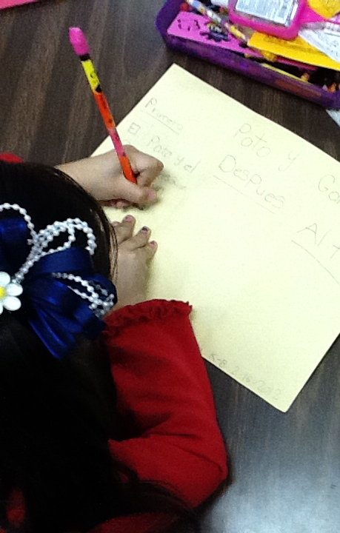
What are the two goals of Sheltered Instruction?
Make content comprehensible
Develop Academic Language

Slide 6
Content and Language Objectives

Slide 7
The What and the How
Content Objectives come from the TEKS
What am I going to learn?
Language Objectives come from the ELPS
How will I demonstrate my learning through listening, speaking, reading and/or writing?
Content and Language Objectives

Slide 8
Content Objective - Sample
Science TEKS: Differentiate between structure and function in plant and animal cell organelles including cell membrane, cell wall, nucleus, cytoplasm, mitochondria, chloroplast and vacuole.
Student Friendly format: Today I will compare and contrast the cell structures and functions of plants and animals.

Slide 9
Language Objective - Sample
Content Objective:
Today we will compare and contrast the cell structures and functions of plants and animals.
Language Objective: Today I will write an essay comparing and contrasting plant and animal cells utilizing transitional phrases.

Slide 10
Key Points to Remember
Make objectives student friendly and appropriate for grade level.
Objectives are for students, not for the adults in the classroom.
Post eye level.
Review with students before, during and after each lesson.

Slide 11
Randomization Techniques

Slide 12
Write-Read-Read-Trade
1. Stand up when you complete in writing one of these sentences:
  My teachers select who they call on by…
  In my classrooms, my teachers include randomization techniques because…
  The most beneficial randomization technique I have observed is… because…
  2. Find someone who was not next to you, share your answers and trade your papers.

Slide 13
Randomization Techniques
Randomize and rotate who is called on,
so students of all language levels can participate
Is it possible to randomize and differentiate instruction at the same time?

Slide 14
Randomization Techniques
Lucky sticks
Beach ball
Index cards
with student names
Class list/roster
Color/numbers
Birthdays
Physical characteristics: longest hair, eye color…
Jenga
Pick up sticks
Career cards
Apps
Popcorn

Slide 15
Total Response Signals

Slide 16
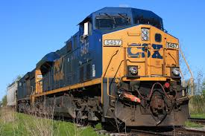
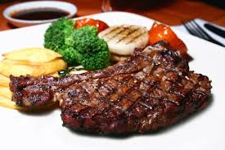
Total Response Signals
Why is it important to check for understanding along the way?

Slide 17
Written Responses
Hold up paper
White boards
Ready Responses
Hands up when ready
Personal Chalkboards
Answers on cards
Thinker’s chin
Stand up when ready
Put your pen on your paper when ready
All eyes on teacher
Making Choices
Open hand/closed hand
Ranking
Rank with your fingers
Thumbs/Pens up/down
Number wheels
Green card/red card
Move to the corner/spot
Rank with your arm
Line up according to response
Knocking/clapping/
cheering

Slide 18
Let’s Play!
Rhea is a moon of Saturn. Which of these facts about Rhea best indicates that it does not have a water cycle in which water changes state?
A Its radius is 765 km.
B Its density is about 1.3 kg/m3.
C Its period of rotation is about 4.5 Earth days.
D Its temperature is between −174°C and −220°C.
Find the Correct Answer

Slide 19
Let’s Play!
Evaporation is part of the water cycle
Refraction is part of the water cycle
Condensation is part of the water cycle
      I believe number… is a fib because…
Find the Fib

Slide 20
The Power of Cognates
Notes:
3 hours

Slide 21
The Power of Cognates
La chimica è la scienza che studia la composizione della materia ed il suo comportamento in base a tale composizione.
Make a list of all words that are similar in English or Spanish and Italian

Slide 22
The Power of Cognates
La chimica è la scienza che studia la composizione della materia ed il suo comportamento in base a tale composizione.
Make a list of all words that are similar in English or Spanish and Italian

Slide 23
Developing Academic Vocabulary

Slide 24
1. When you can complete this sentence in your mind, please stand up.
Academic vocabulary development is important for ALL students, but especially for ELLs, because…
2. Find someone not seating next to you to share your thoughts.

Slide 25
What does this mean?
Carving is appropriate for most green and blue slopes and even some black slopes. However, if you try to carve through moguls, especially in packed powder or corn snow, you’re going to face-plant.

Slide 26
What does this mean?
Carving is appropriate for most green and blue slopes and even some black slopes. However, if you try to carve through moguls, especially in packed powder or corn snow, you’re going to face-plant.

Slide 27
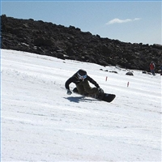
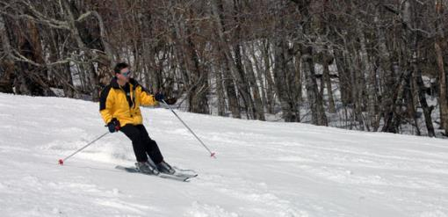
Would this help?
These men are carving.

Slide 28
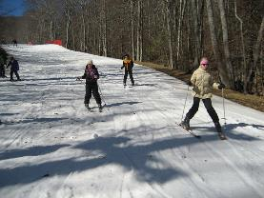
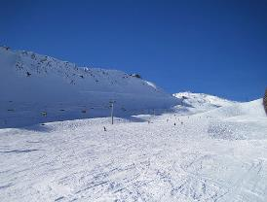
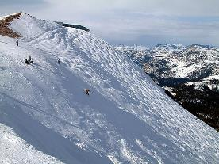
How about this?
Green Slope
Blue Slope
Black Slope

Slide 29
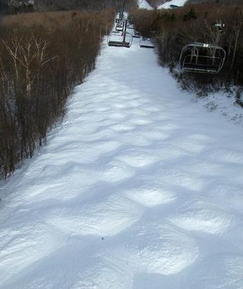
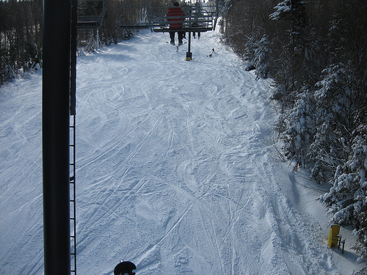
Moguls Packed Powder

Slide 30
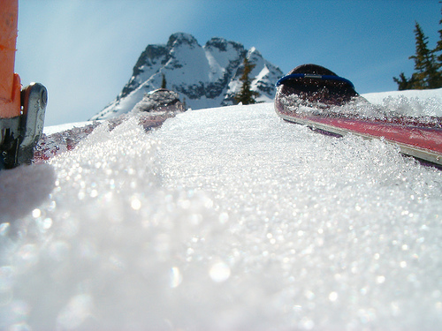
Corn Snow

Slide 31
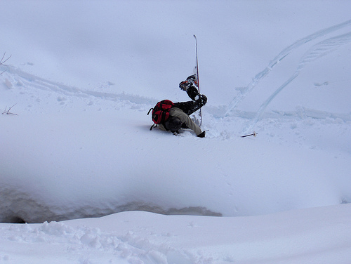
Face-plant

Slide 32
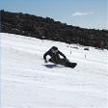








Carving is appropriate for most green and blue slopes
and even some black slopes. However, if you try to carve
through moguls, especially in packed powder or corn snow
you’re going to face-plant.
apropiado
especialmente

Slide 33
Tickets Out
I used to think…
But now I know…

Slide 34
Thank you for your participation!
KARINA E. CHAPA, M. ED.
KCHAPA@ESC1.NET
FACEBOOK: REGION ONE ESC BILINGUAL
TWITTER @ESC1BILINGUAL @BILINGUALPRIDE

